Slide 1
NLP Project for Disaster Tweet Classification
BY:-Dharmendra Kumar
DATE:- July 2025

Slide 2

Agenda
PROJECT OVERVIEW
DATA ANALYSIS
EDA
Disaster Non- Disaster Tweet
Characters used in disaster and non-disaster tweet
Pair Plot
Correlation
Disaster Word Cloud
30 Most common words used in Non-Disaster Tweet
30 Most common words used in Disaster Tweet
DEEP LEARNING
APP.PY , HTML , Dashboard

Slide 3
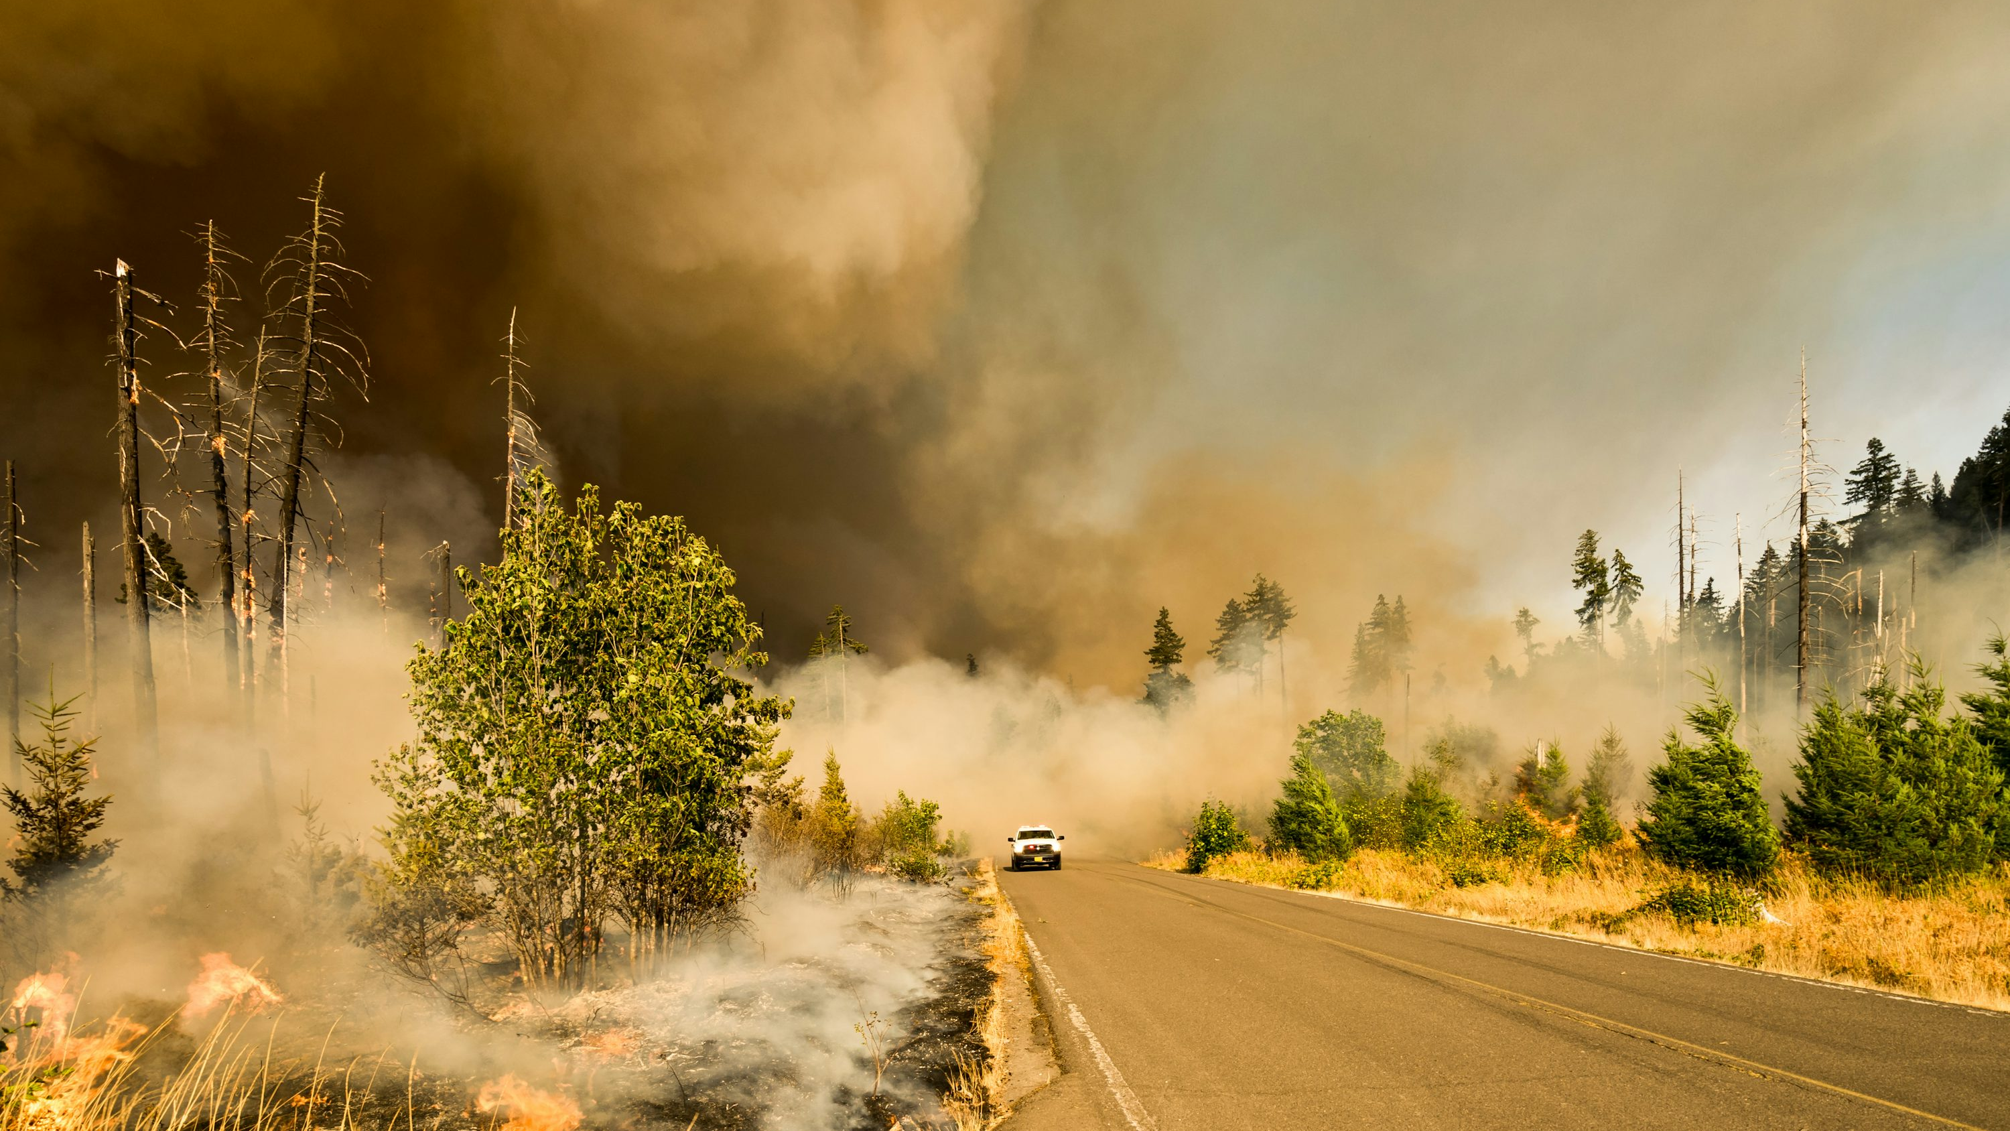
Project Overview
In today's digital age, social media platforms like Twitter play a crucial role in disseminating information, especially during emergencies and disasters. However, distinguishing between tweets that genuinely indicate a disaster and those that do not can be challenging, even for humans. As a result, there is growing interest from various organizations, such as disaster relief agencies and news outlets, in developing automated methods to monitor Twitter for real-time disaster alerts.

Slide 4
Data Analysis
Datasets
Historical store sales
Promotions
Holidays
Assortment
Competition.
Key Field
total record= 7613
columns = 5
Missing Values :-
keywords = 0.8% missing
Location = 33% missing

Slide 5
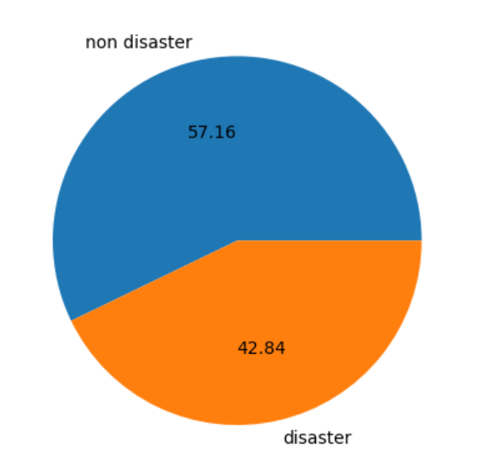
Disaster Non- Disaster Tweet
This Chart Shows that 57.16 % of the total tweet are non- disaster tweet whereas 42.84 % Of the total tweet are non- disaster tweet

Slide 6
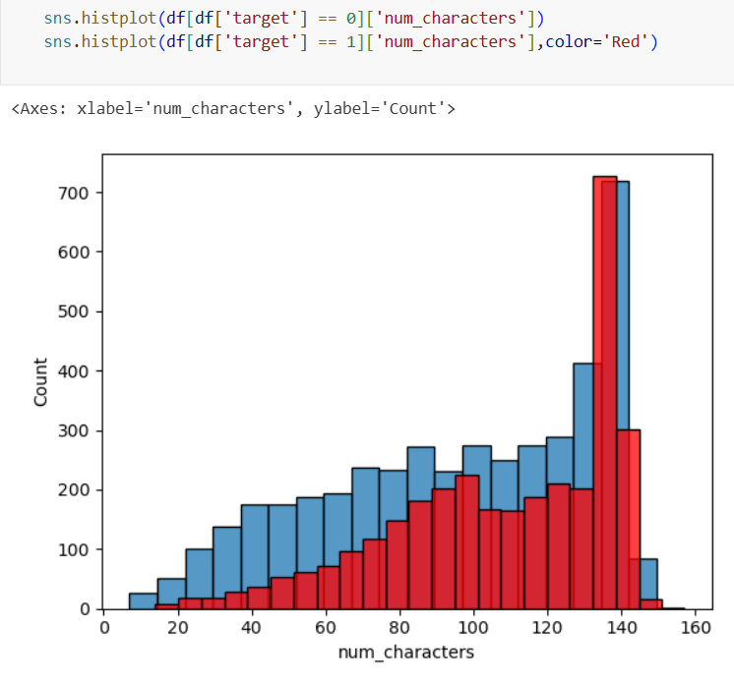
Characters used in disaster and non-disaster tweet
Both types of tweets peak near 140 characters, indicating users tend to use the full tweet length regardless of the topic.
Disaster tweets (Red) are more concentrated in the 60–140 character range, showing higher density in longer tweets.
Short tweets (< 60 characters) are more common among non-disaster tweets.
This suggests that disaster-related tweets often contain more detailed content, possibly including descriptions, locations, or emergency details.

Slide 7
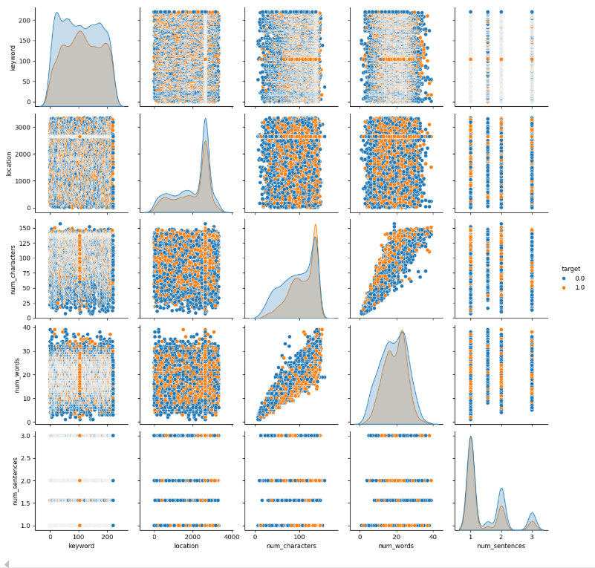
Pair plot
num_characters vs num_words: There is a strong positive correlation. As character count increases, word count also rises in both tweet types.
num_sentences: Most tweets contain 1–2 sentences. No major difference in sentence count between disaster and non-disaster tweets.
keyword and location: These features are categorical and sparse. No clear distinction visible in this format — requires further preprocessing like encoding or grouping.
Disaster tweets (orange) tend to have slightly higher character and word counts, suggesting more detailed content.
Non-disaster tweets (blue) are more frequent with lower values in num_characters and num_words.

Slide 8
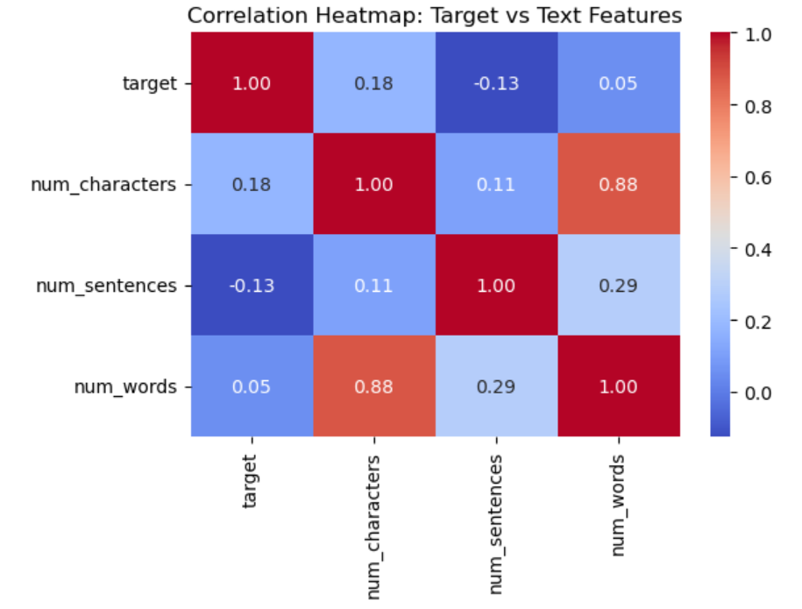
Correlation
target vs num_characters: Correlation = 0.18 → Weak positive correlation. Disaster tweets tend to be slightly longer in character count.
target vs num_words: Correlation = 0.05 → Very weak correlation. Word count alone does not strongly differentiate disaster from non-disaster tweets.
target vs num_sentences: Correlation = -0.13 → Slight negative correlation. Disaster tweets may be more concise in terms of sentence count.
num_characters vs num_words: Correlation = 0.88 → Strong positive correlation, as expected. Longer tweets have more words.
num_words vs num_sentences: Correlation = 0.29 → Moderate relationship, suggesting sentence count grows modestly with word count.

Slide 9
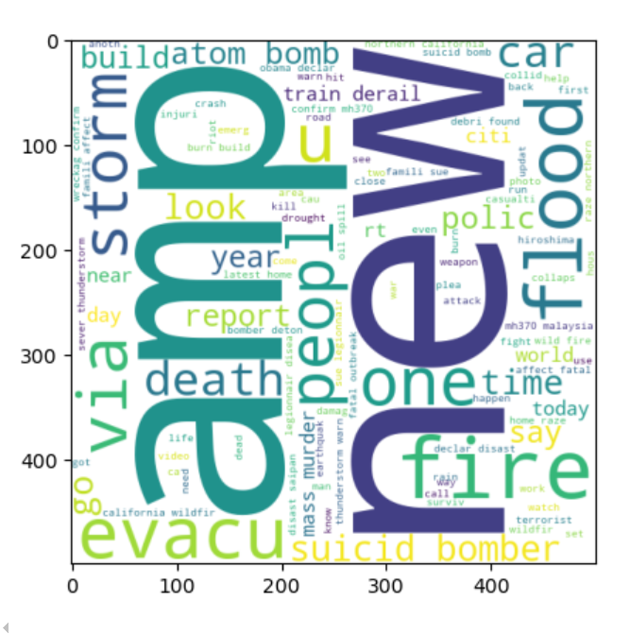
Disaster Word Cloud
The word cloud highlights the most frequent words in disaster-related tweets.
Prominent terms include:
🔥 fire, 🌊 flood, 🌪️ storm, 🚨 evacu, ☠️ death, 💣 bomb, suicid, bomber
📢 report, police, people, news, emergency
Many words reflect emergency events, natural disasters, and violent incidents.
Words like “amp”, “via”, and “news” are common due to retweets and shared links.

Slide 10
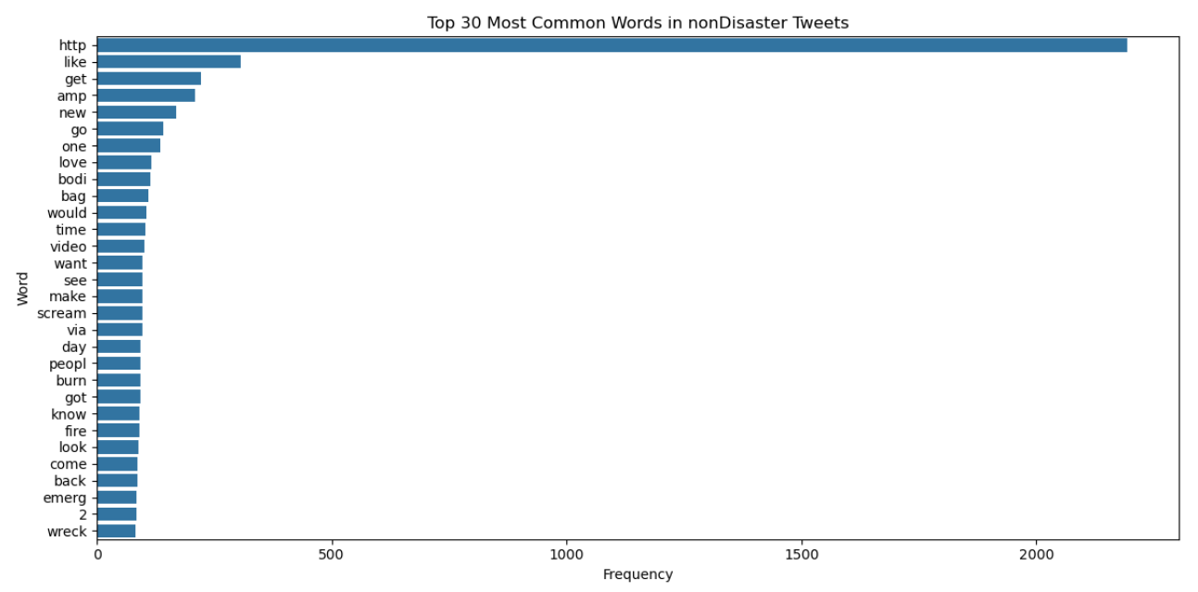
30 Most common words used in Non-Disaster Tweet
The most frequent word is “http”, indicating a high number of links and shared content in non-disaster tweets.
Common words like “like”, “get”, “love”, “video”, and “time” reflect a casual or social tone, unrelated to emergencies.
Words such as “amp”, “via”, and “new” also appear frequently due to retweets and media sharing.
A few disaster-related words like “fire”, “burn”, and “wreck” exist but are used in a non-emergency context (e.g., metaphors, sarcasm, or casual conversation).

Slide 11
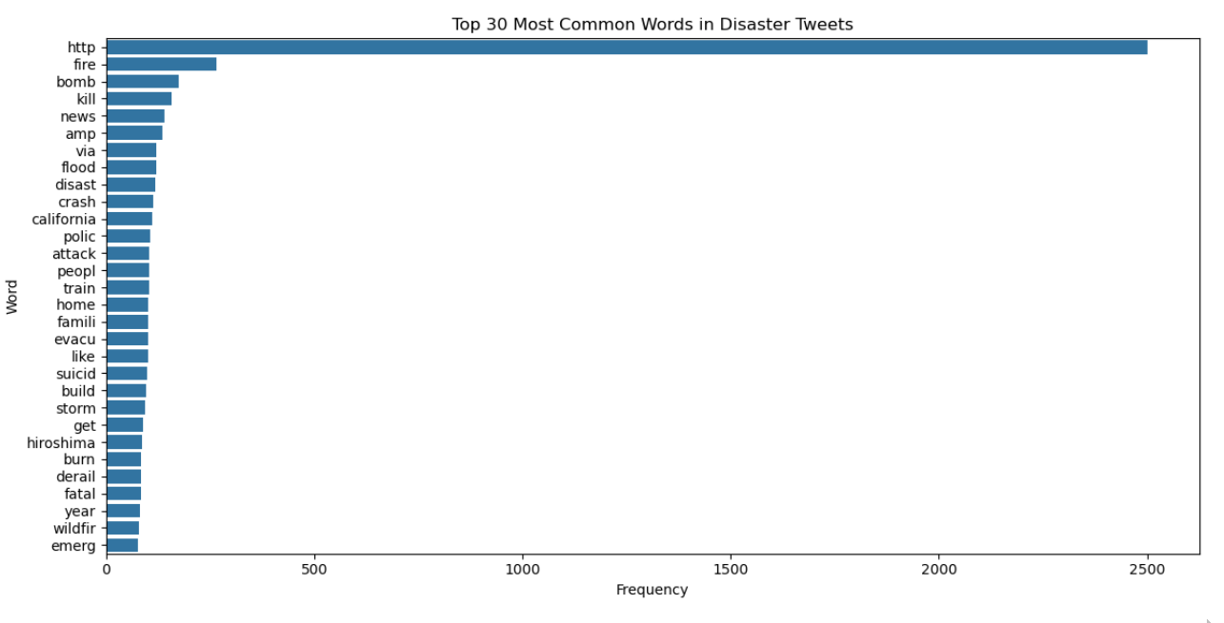
30 Most common words used in Disaster Tweet
The most frequent term is “http”, showing that many disaster tweets include links to news or emergency updates.
High-frequency disaster-related words include:
🔥 fire, 💣 bomb, ☠️ kill, 🚨 disast, 🚓 polic, 🌊 flood, 🚆 crash, 🌪️ storm
Other emotionally charged or action-related terms like “attack”, “evacu”, “suicid”, “fatal”, and “burn” are common.
Mentions of specific events/places (e.g., “hiroshima”, “california”, “wildfir”) suggest real incidents being discussed.

Slide 12
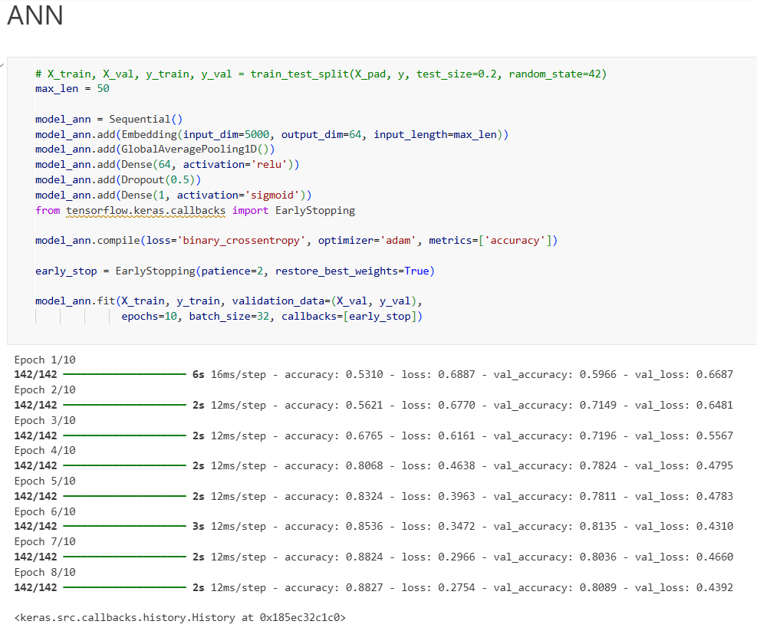
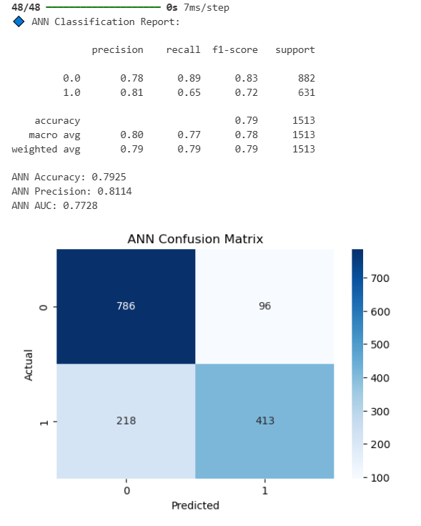
Deep Learning

Slide 13
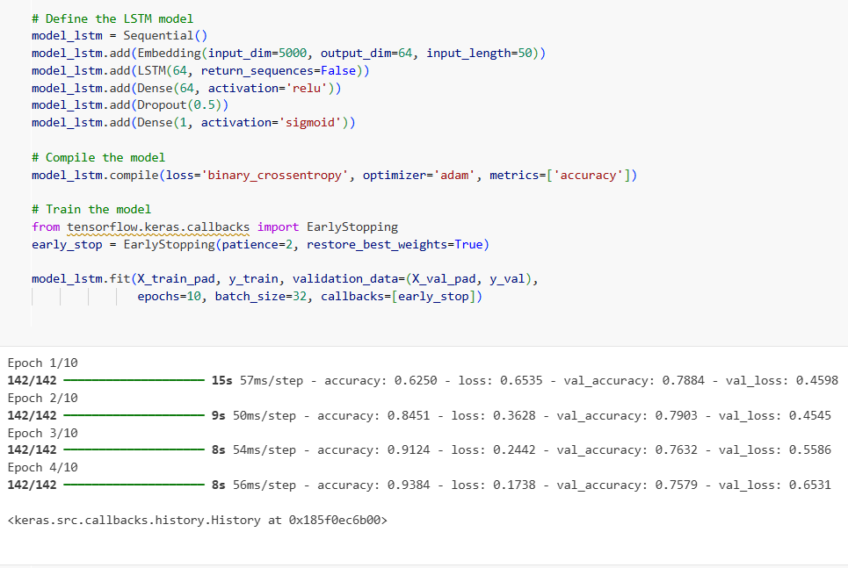
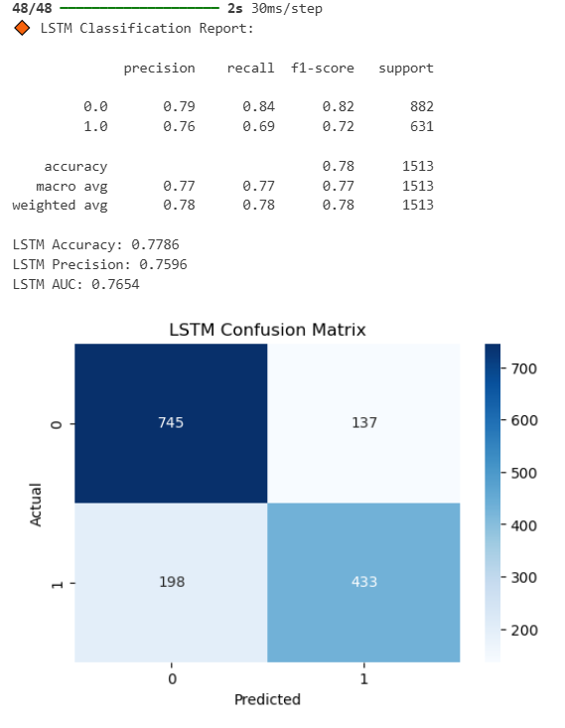
Deep Learning

Slide 14
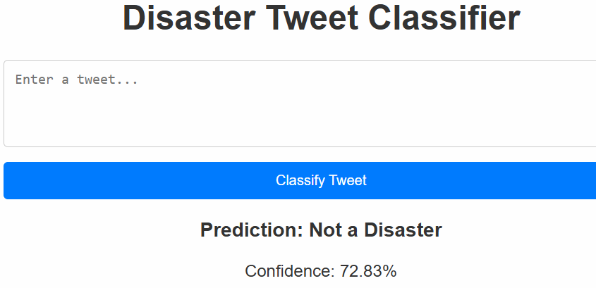
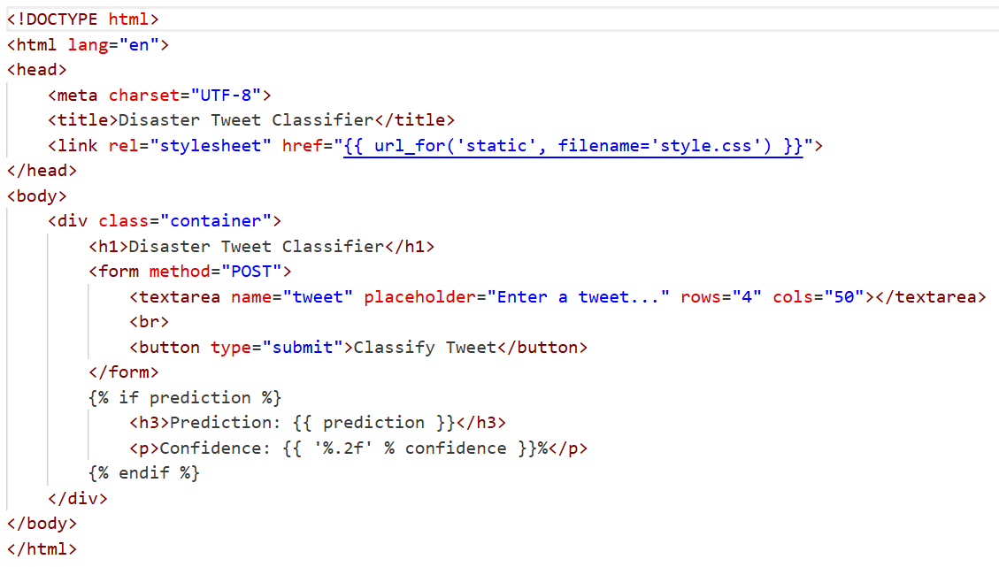
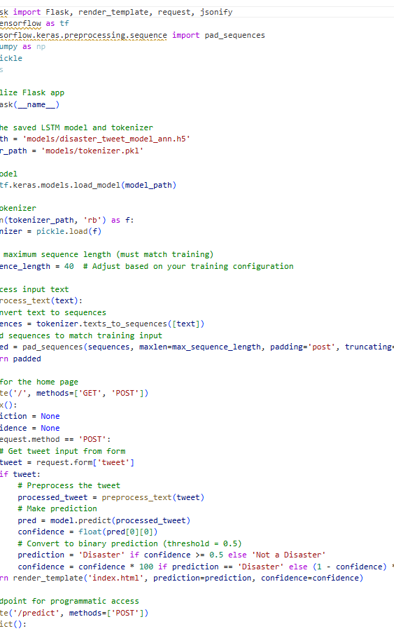
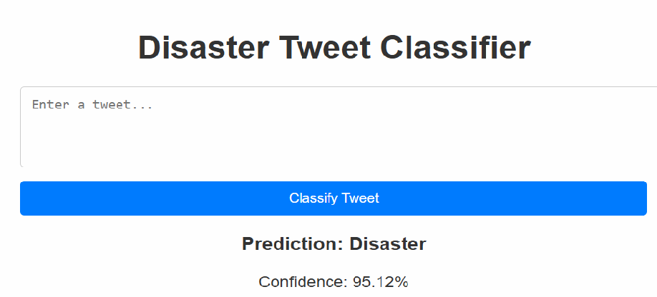
HTML , app.py

Slide 15

Thank You

